Slide 1
Future Web Architecture

Slide 2
Future Web Architecture
The "problem" with the Modern Web Architecture model
Although the current web architecture model solves many of the UX problems that have faced developers for years, it still has several technical drawbacks:
For years, XML was at the heart of the data-transport layer. XML, while being ubiquitous, is:
written in a different language
carries a heavy footprint
usually requires extra JavaScript code to iterate through and render nodes of data
The Ajax model still relies on a classic web server to handle HTTP Request processing. Drawbacks here include:
server-side architecture which includes server-side technology and dedicated language
additional servers, additional memory, more resources, etc.
adds one more "failure point" to the overall model
The Ajax model still relies on a relational database as a data store, drawbacks here include:
model is ancient, slow, process intensive, and can't handle volume of modern web applications
additional servers, additional memory, more resources, etc.
adds one more "failure point" to the overall model

Slide 3
Future Web Architecture
How the future Web will eliminate "classic resources"
The future (and to some extent current) web architecture model eliminates many "classic resources" that have acted as failure points to many Web developers starting with JSON replacing XML.
While the web application server remains, the server-side technology is gone! The web application server now hosts other resources and its role has shifted to handle other tasks.
The relational database model is eliminated! The model that E.F. Codd invented way back in 1970 while working for IBM and that has been used exclusively for almost 50 years is completely eliminated!
Changes are made to various components of the architecture model including how data is stored, how interfaces (views) are presented to the user, how JavaScript makes calls for data on the client, how data is queried, and more.
Most importantly, JavaScript plays a much more critical role in Web development that it ever did before. This is why it's critical that you learn it now!

Slide 4









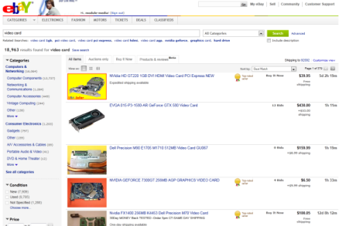


Future Web Architecture
The Future Architecture Model: The NoSQL Model
Visitor (Client) HTML, CSS, JavaScript
Application Server Node.js
View HTML + CSS
React.js
JSON Data
Interaction
HTTP Verbs GET, POST, PUT, DELETE
Data Request (Query)
JSON
NoSQL Database MongoDB, CouchDB, Couchbase, Oracle NoSQL, Cassandra, HBase, Firebase, IBM Domino, FoundationDB, etc.

